Slide 1
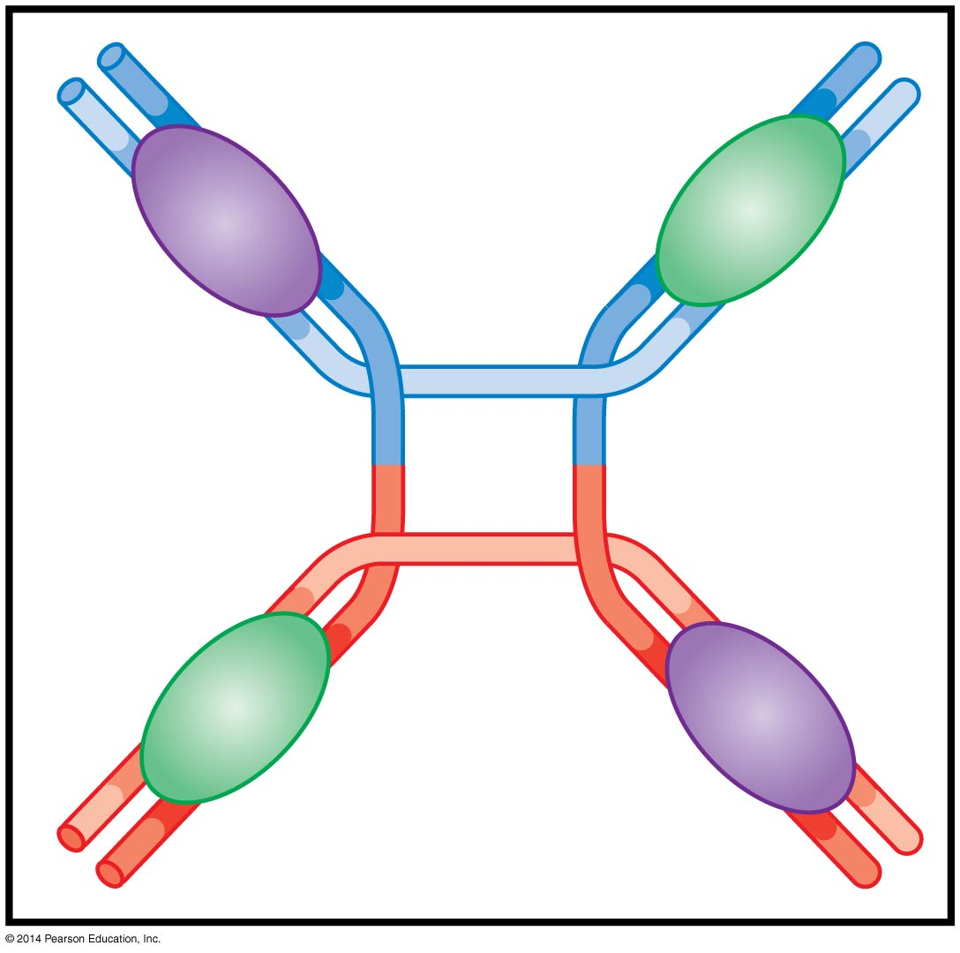
Site-specific recombination and transposition of DNA
BT 451
Chapter 12

Slide 2
Two classes of genetic recombination
Homologous recombination → recombination at sites with same sequence
Other types of recombination
Conservative site specific recombination (CSSR)
Between two defined sequence elements
2. Transpositional recombination
Between specific sequences and nonspecific DNA sites
Both share “recombinases” that recognize specific sequences where recombination will occur within a DNA molecule Protein-DNA complex called synaptic complex .

Slide 3
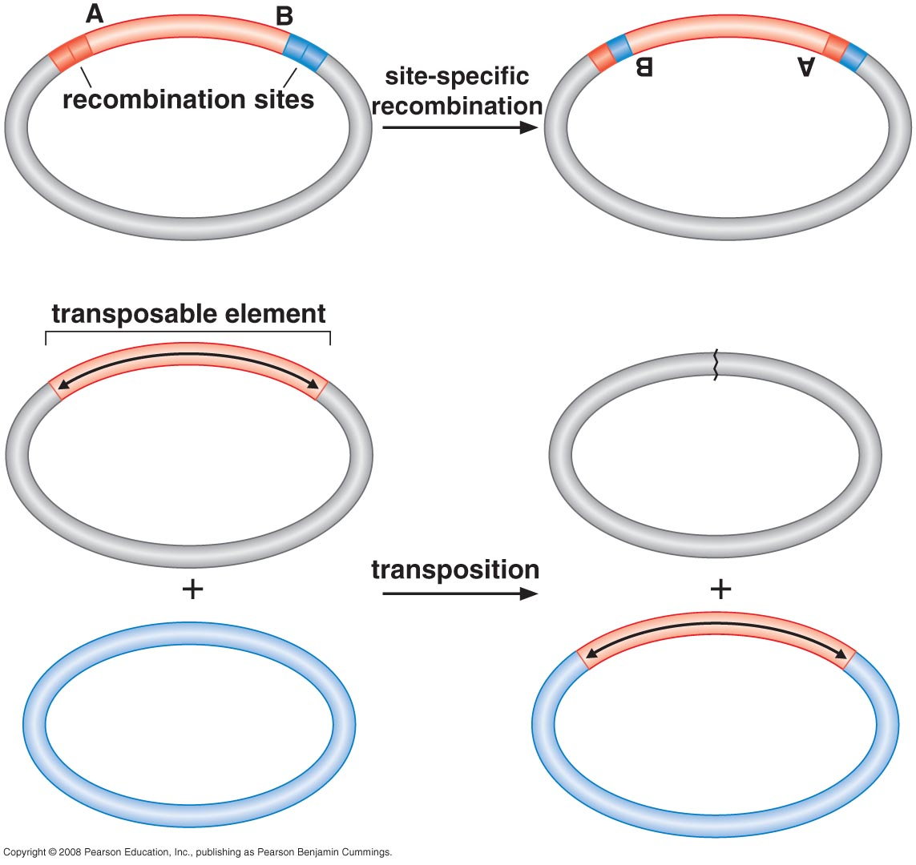

Slide 4
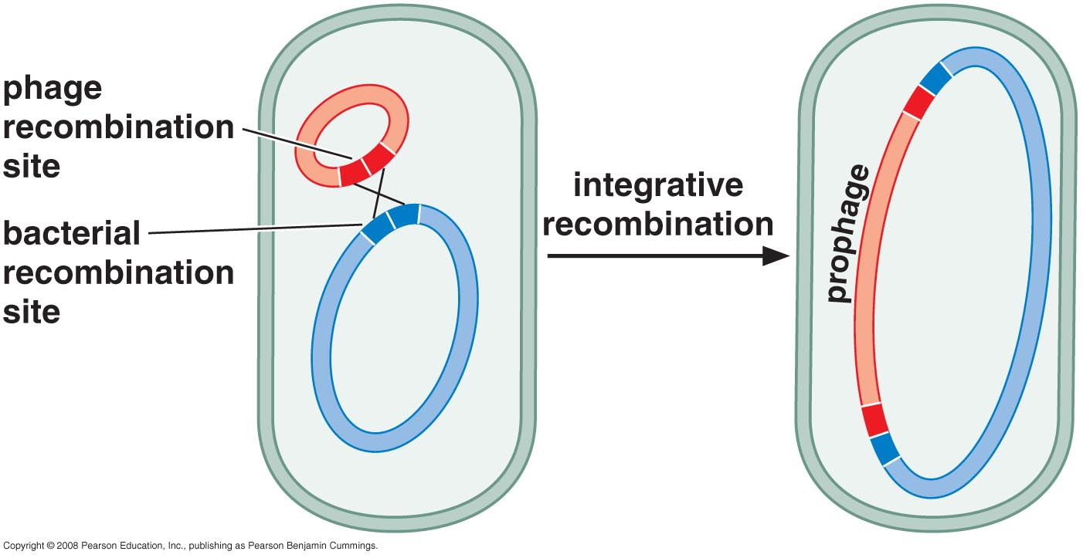
Conservative site specific recombination (CSSR)
Recombination between two defined sequence elements
The segment to be moved carries a short sequence elements called recombination sites where DNA exchange occurs
Integration of the λ genome into the chromosome of the host cell

Slide 5
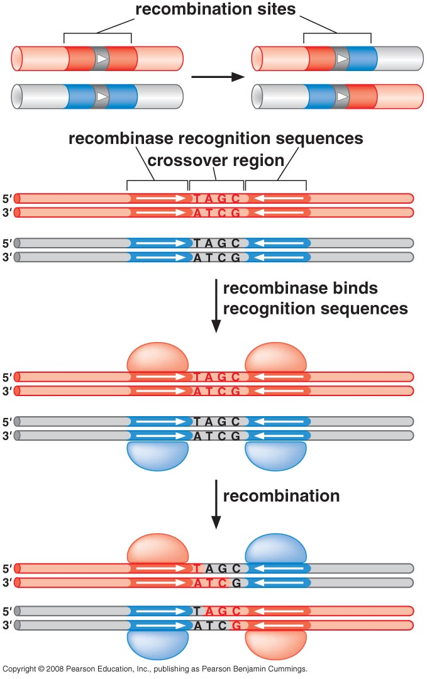
Recombination Sites
Symmetric recombinase recognition sequences
Short asymmetric crossover region
Symmetric recombinase recognition sequences:
These are palindromic sequences recognized by recombinases (enzymes that mediate site-specific recombination). Symmetry ensures that the recombinase binds consistently and enables alignment of the DNA strands during the recombination process.
Short asymmetric crossover region:
This refers to a non-palindromic or non-symmetric sequence within the recognition site. The asymmetry ensures directional recombination, determining where the strand exchange occurs and the polarity of the reaction.
Binding: Recombinase recognizes and binds to specific DNA sequences (recombination sites).
DNA Cleavage: Cleaves the DNA strands at the recognition sites.
Strand Exchange: Facilitates the exchange of DNA strands between two recognition sites.
Re-Ligation: Rejoins the DNA strands to form a new combination of DNA sequences.

Slide 6
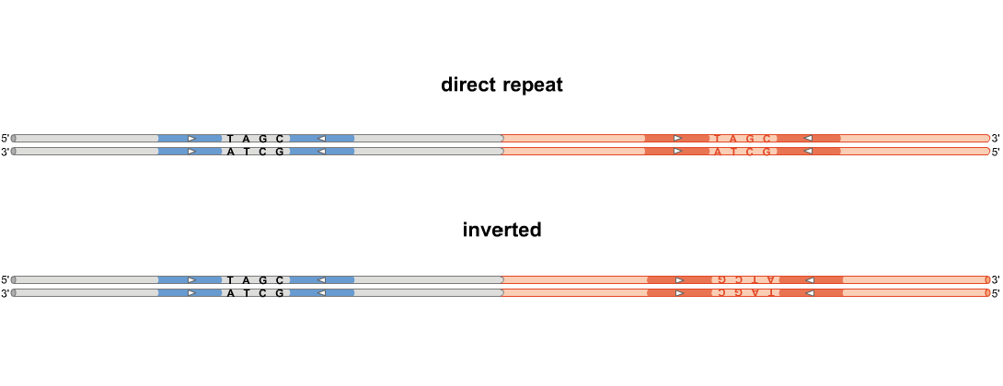
Polarity of Recombination Sites
Relation of the crossover sites
Same direction → direct repeat
inverted direction → inverted repeat

Slide 7
Relation of the Crossover Sites
Same Direction → Direct Repeat:
The resulting arrangement creates a direct repeat when the recombination sites (e.g., recognition sequences) are oriented in the same direction.
Example:
Original: Site1 → DNA → Site2 → DNA
After recombination: Depending on the mechanism, the DNA segment between the sites may be excised or duplicated.
This is typically seen in processes like DNA segment excision, such as phage excision from a bacterial chromosome.
Inverted Direction → Inverted Repeat:
When the recombination sites are oriented in opposite directions (one site points forward, and the other points backward), the result is an inverted repeat.
Example:
Original: Site1 → DNA ← Site2
After recombination: The DNA segment between the sites may undergo inversion (flipping the sequence).
This is commonly observed in gene inversion events, which can regulate gene expression or switch between alternative sequences.
Biological Implications
Direct Repeat (Same Direction):
Leads to excision or duplication.
Important in processes like plasmid integration/excision (e.g., λ phage integration).
Inverted Repeat (Opposite Direction):
Leads to sequence inversion.
It is found in mechanisms like bacterial phase variation, where flipping a segment controls gene expression (e.g., switching between "on" and "off" states for specific genes).

Slide 8
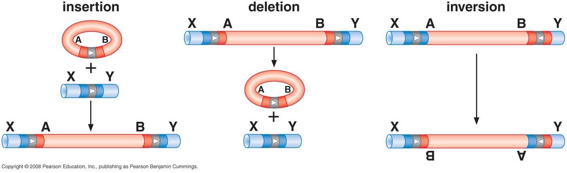
Conservative Site-Specific Recombination (CSSR) can generate 3 different types of DNA rearrangements:
Depends on the organization of the recombination sites

Slide 9
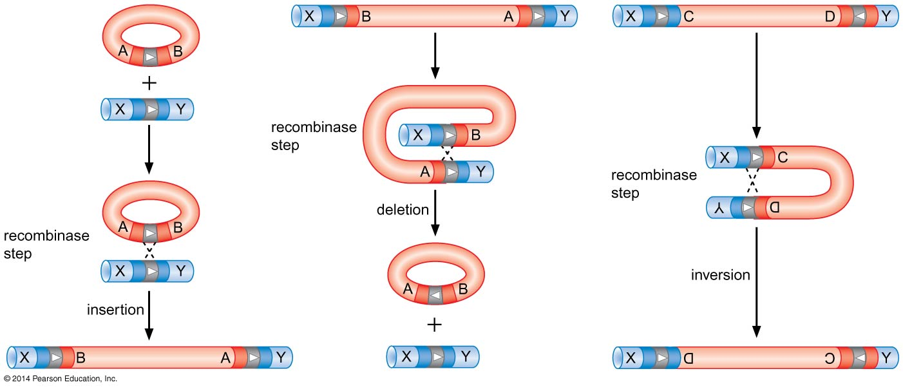
Figure 12-3
Three Types of CSSR recombination
Notes:
9
Figure 12-3

Slide 10
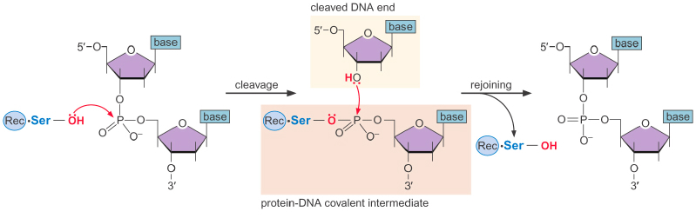
Recombinase Mechanism
Two families of recombinases:
Serine recombinases
Tyrosine recombinases
Mechanisms are similar:
aa attacks phosphodiester bond
Form protein-DNA Intermediate
No external energy is needed
Every DNA bond that is broken is resealed by the recombinase.

Slide 11
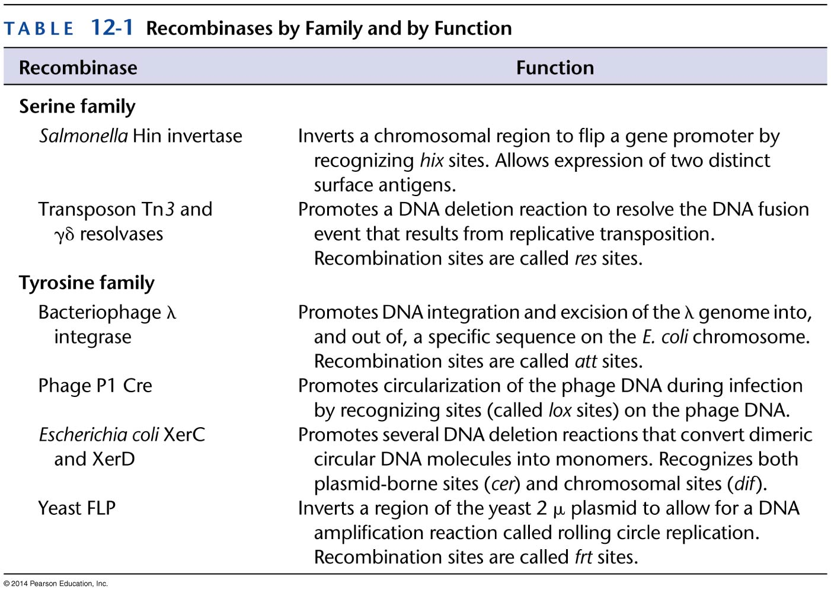
Table 12-1
Notes:
11
Table 12-1

Slide 12
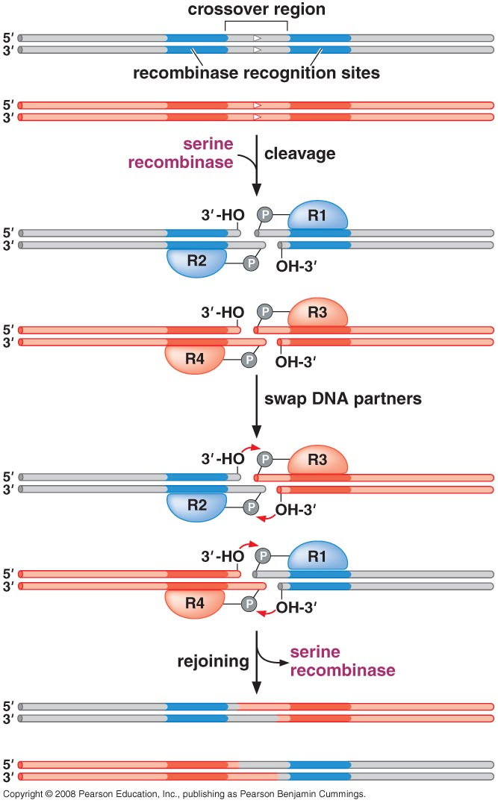
Serine Recombinases introduce DSB in DNA then swap strands to promote recombination
R2 with R3
R1 with R4
The 3’OH ends of each of the cleaved DNA strands can attack the recombinase-DNA bond in their partner segment

Slide 13
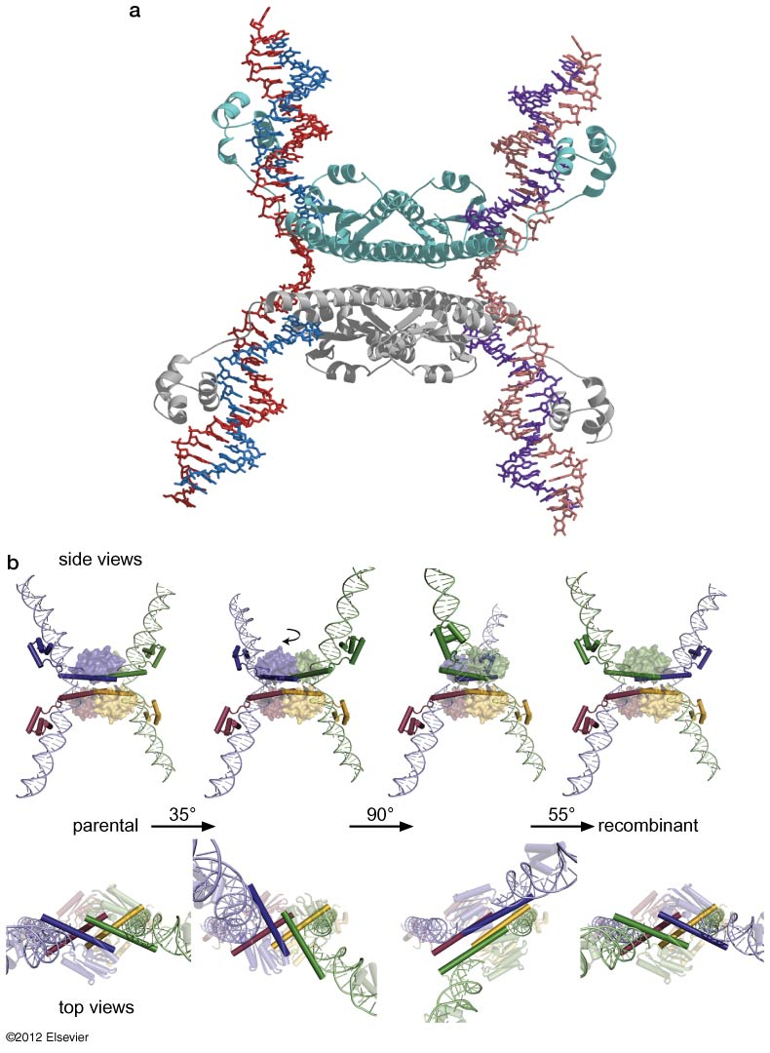
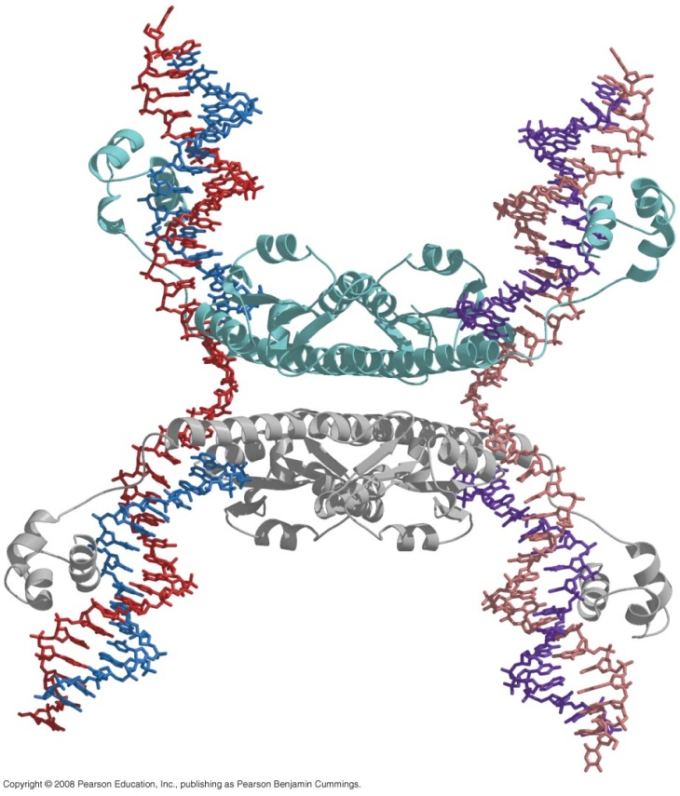
Serine Recombinases

Slide 14
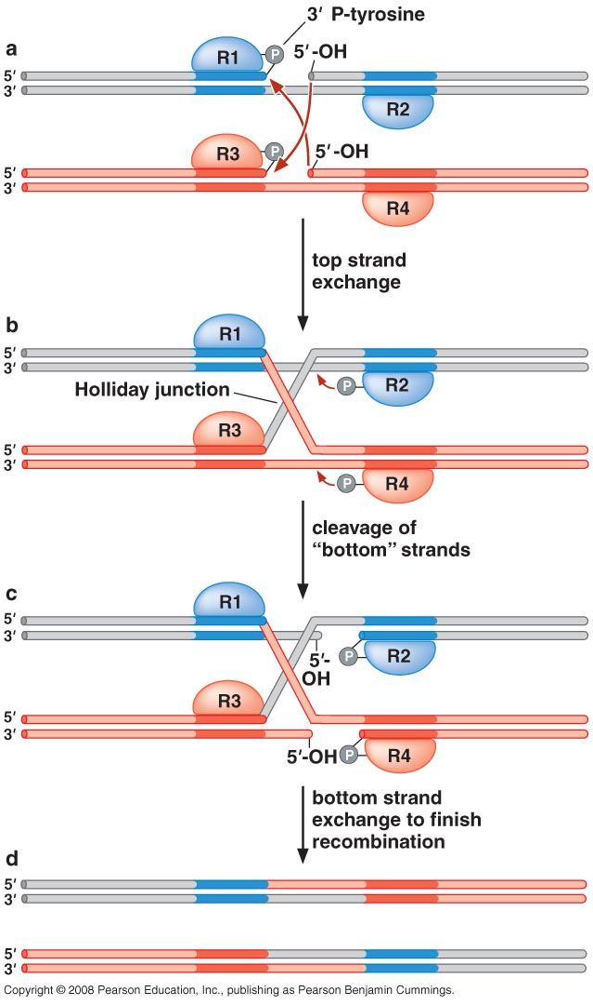
Tyrosine Recombinases break and rejoin one pair of DNA strands at time to form heterodulpex and Holiday junction.

Slide 15
Tyrosine Recombinase : Cre Recombinase
Cre is an enzyme encoded by phage P1, which functions to circularize the linear phage genome during infection.
The recombination sites on the DNA, where Cre acts, are called lox sites.
Cre–lox is a simple example of recombination by the tyrosine recombinase family.
Only Cre protein and the lox sites are needed for complete recombination.
Cre is also widely used as a tool in genetic engineering.

Slide 16
The Cre–lox structures reveal that recombination requires four subunits of Cre, with each molecule bound to one binding site on the substrate DNA molecules.
The conformation of the DNA is generally a square planar four-way junction (holiday junction) with each “arm” of this junction bound by one subunit of Cre.
The pair of subunits in this active conformation switches as the reaction progresses.
This switching is critical for controlling the progress of recombination and ensuring the sequential “one strand at a time” exchange mechanism.

Slide 17
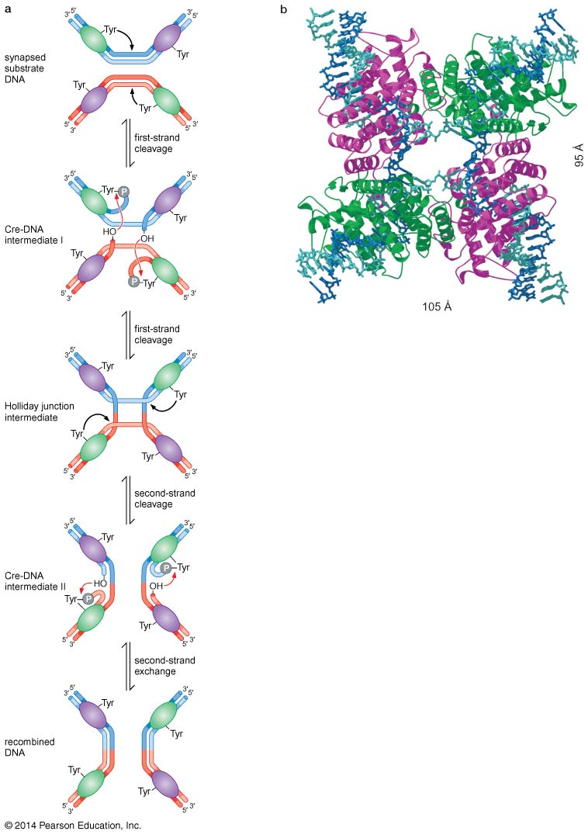
Figure 12-9
Mechanism of site-specific recombination by the Cre recombinase.
The series of intermediate Cre–DNA structures that reflect the sequential “one strand at a time” mechanism of exchange.
(b) The crystal structure of Cre bound to the Holliday junction intermediate.
Notes:
17
Figure 12-9

Slide 18
Biological Roles of Site Specific Recombination

Slide 19
Conservative Site Specific Recombination
Phage insert their DNA into the host chromosome
Used to alter gene expression
Flagellar antigen variation in Salmonella typhimurium
Used to maintain integrity of circular DNA molecules
Resolving plasmid multimers
All SSR systems depend critically on the assembly of the recombinase on the DNA and the bringing together of the two recombination sites
Assembly could be simple or complicated requires architectural proteins that bind specific DNA sequences and bend the DNA.

Slide 20
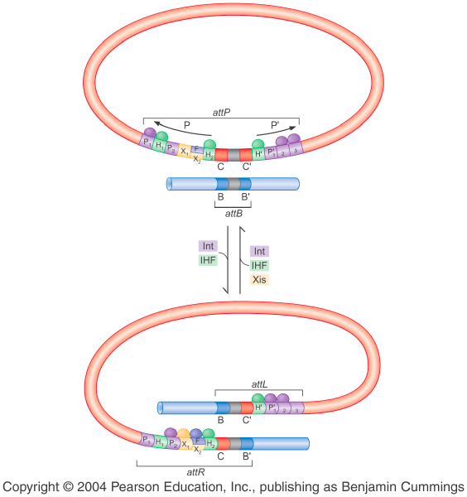
I-Integration of λ Phage
Integration happens at specific times
Core segment
λInt binding sites
Crossover site
λ Integrase (λInt) catalyzes recombination between two att sites (a tyrosine recombinase)
Has two domains one binds the Arms sites and the other binds to the core recognition sites
Core segment
Notes:
Binding of other architectural proteins governs the directionality and efficiency of recombination

Slide 21
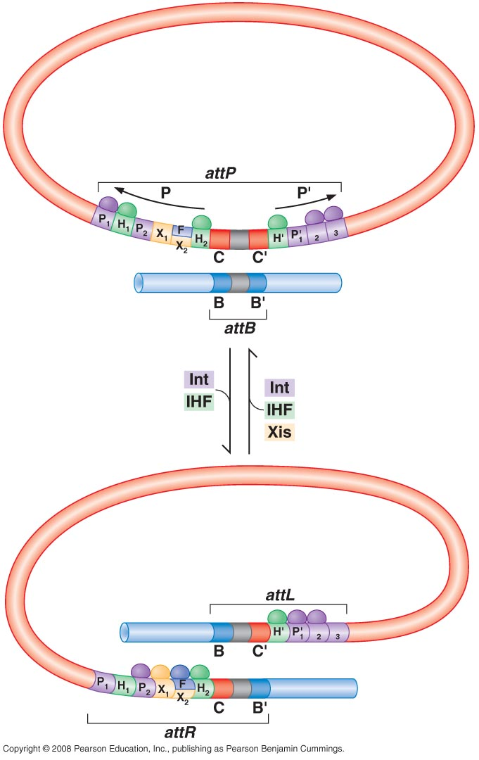
Integration of λ Phage Genome in Bacterial Chromosome
Integration requires attB, attP, λInt and IHF (integration host factor)
The function of IHF is to bring together the λInt sites on the DNA arms with the sites present at the central core. Thus, bending of the DNA allows to find the weak core sites and to catalyze recombination
Two new hybrid sites are generated at the junctions between the phage and the host (attL and attR)

Slide 22
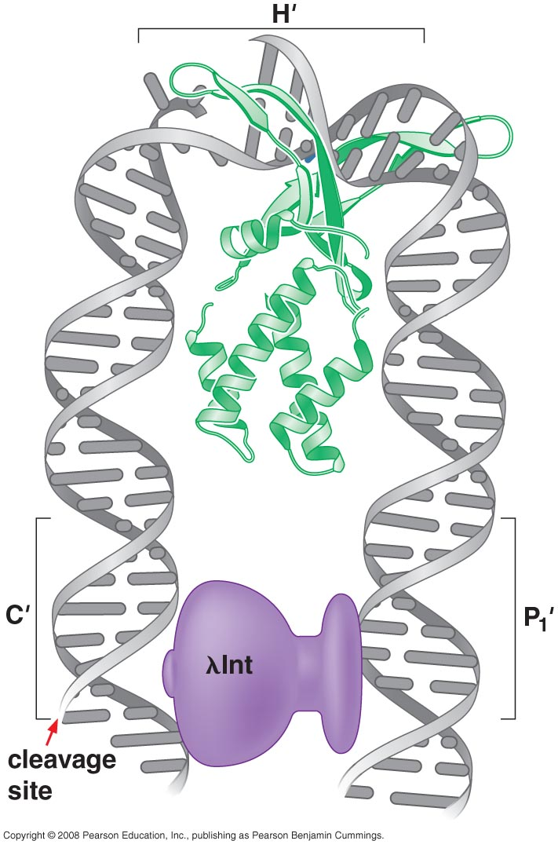
λInt and IHF stabilize bent DNA
Sequence dependent DNA binding protein
Introduce >160°
Bring together λInt sites of arms & core

Slide 23
Bacteriophage λ excision requires a new DNA-bending protein
Xis architectural protein (phage encoded)
Bind with X1, X2
Bend > 140°
Together Xis, λInt and IHF stimulate excision by assembling an active protein-DNA complex at attR
Xis is a phage-encoded protein and is only made when the phage is triggered to enter lytic growth.
Its dual action as a stimulatory co-factor for excision and an inhibitor of integration ensures that the phage genome will be free, and remain free, from the host chromosome when Xis is present.

Slide 24
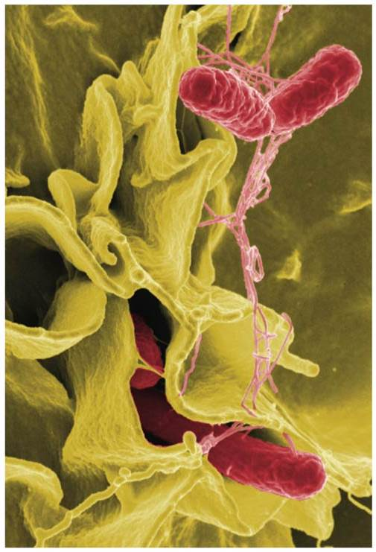
II-Expression of Alternative Genes programmed rearrangements
Flagella are important for mobility
flagella consist of a class of proteins called flagellins
Flagellins are immunogenic and constitute a group of protein antigens called the H antigens

Slide 25
The salmonella Hin recombinase inverts a segment of the bacterial chromosome (~ 1000 bp) to allow expression of two alternative sets of genes.
The genes are alternative forms of flagellin (H1, H2) to avoid recognition by host immune system.

Slide 26
Phase variation in Salmonella H antigens
H1 gene
IS
H2 gene
H1 flagella
H2 flagella
IS=invertible segment

Slide 27
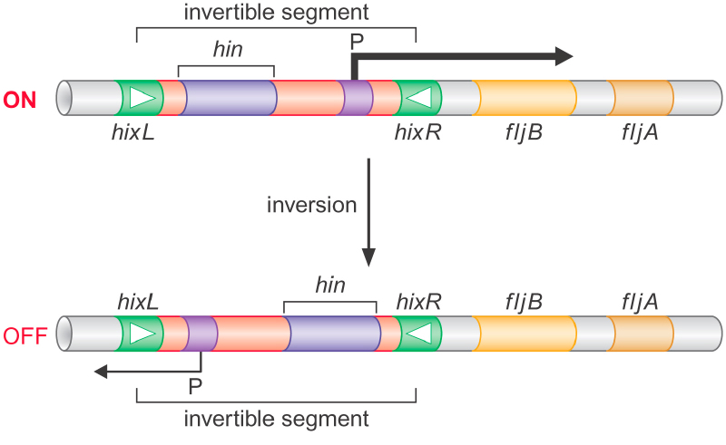
H2 flagellin
Repressor of H1 flagellin
Recombinase called Hin (a Ser recombinase)

Slide 28
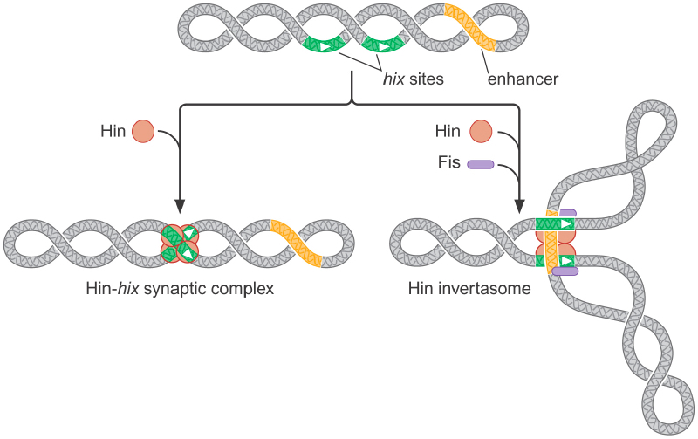
Hin inversion rate increased by enhancers
Requires an enhancer sequence to which Fis protein is required
Fis (factor for inversion stimulation): site-specific DNA bending protein that activates the catalytic steps of Hin
HU (IHF homolog) also facilitates assembly of invertasome.
Rational for control of Hin inversion by Fis-enhancer complex is to ensure that recombination occurs only between hix sites that are present on the same DNA molecule.

Slide 29
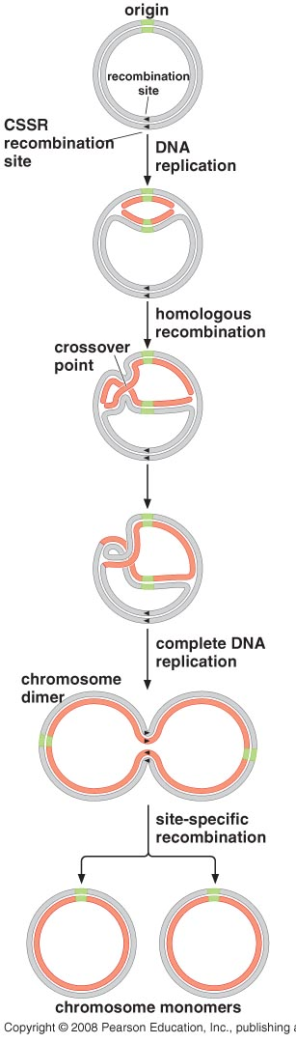
III- Maintain integrity of circular DNA molecules
Circular molecules can recombine
to form dimers and multimers
Specific recombinases (Resolvase) to convert dimers and multimers into monomers.

Slide 30
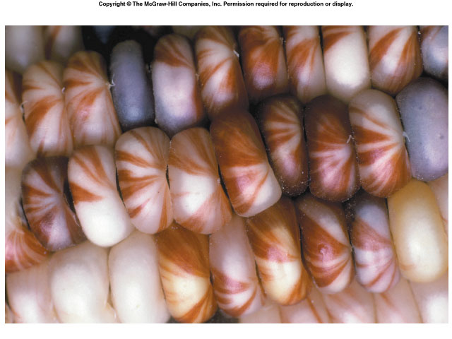
TRANSPOSITION

Slide 31
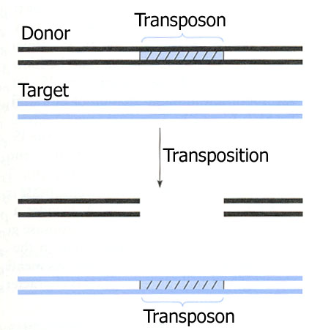
Transposition is the movement of the transposon.
requires proteins to cut and paste the DNA → transposase
NO homology required
Most common source of
Mutations in many organisms

Slide 32
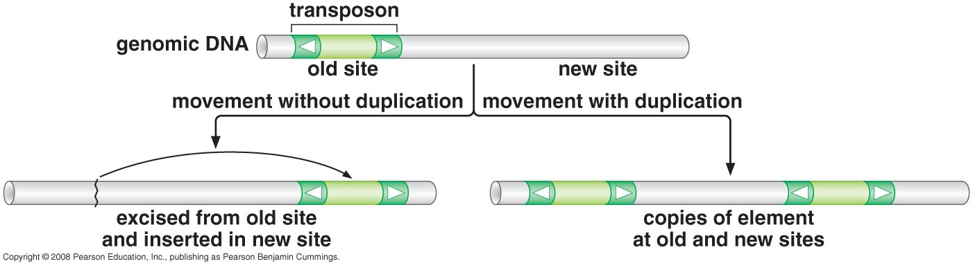
Transposition of a mobile genetic element to a new site in the host DNA.
Recombination, in some cases, involves excision of the transposon from the old DNA location.
In other cases, one copy of the transposon stays at the old location, and another copy is inserted into the new DNA site.

Slide 33
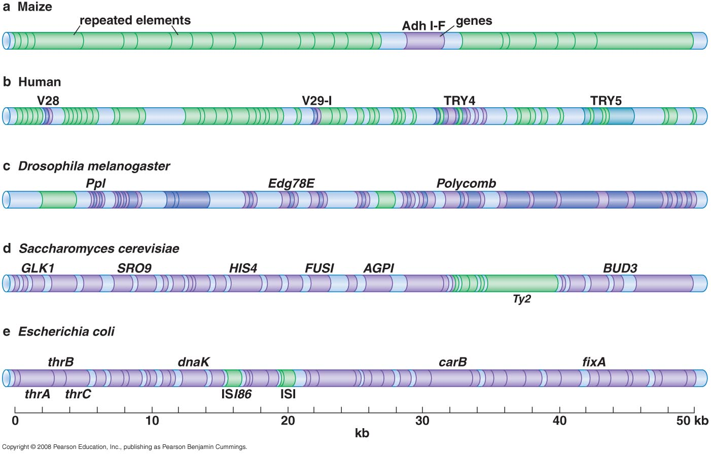
Transposons in Several Genomes
Notes:
TE are present in the genomes of all life forms
Can make > 50% of human and maize genomes
Transposons content in different genomes is highly varaible

Slide 34
Classes of Transposable Elements
DNA Transposons
Autonomous transposons: a pair of inverted repeats and a transposase
Nonautonomous transposons: carry only the inverted repeats
Viral like retrotransposons (long terminal repeat (LTR)
Poly-A retrotransposons (non-viral retrotransposons)

Slide 35
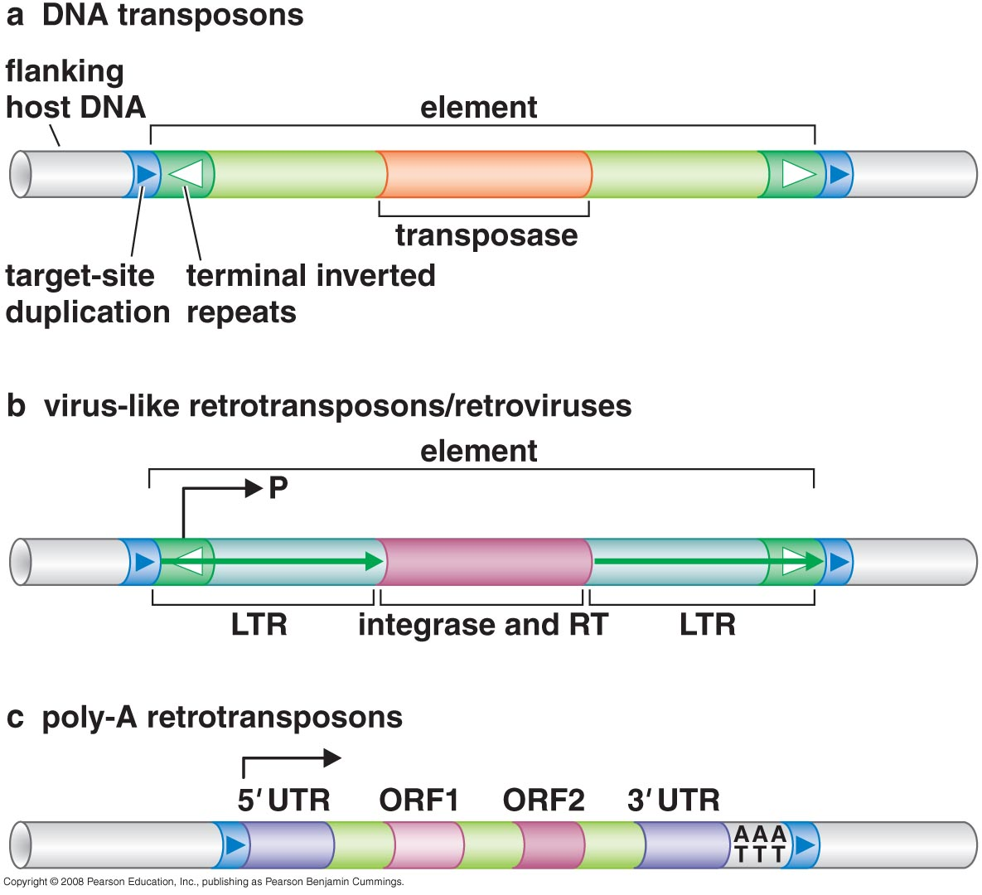
Long terminal repeat
Reveres Transcriptase
Long terminal repeat

Slide 36
Mechanisms of DNA Transposition
Cut & Paste mechanism (transposase)
Replicative mechanism (copy & paste) (integrase)

Slide 37
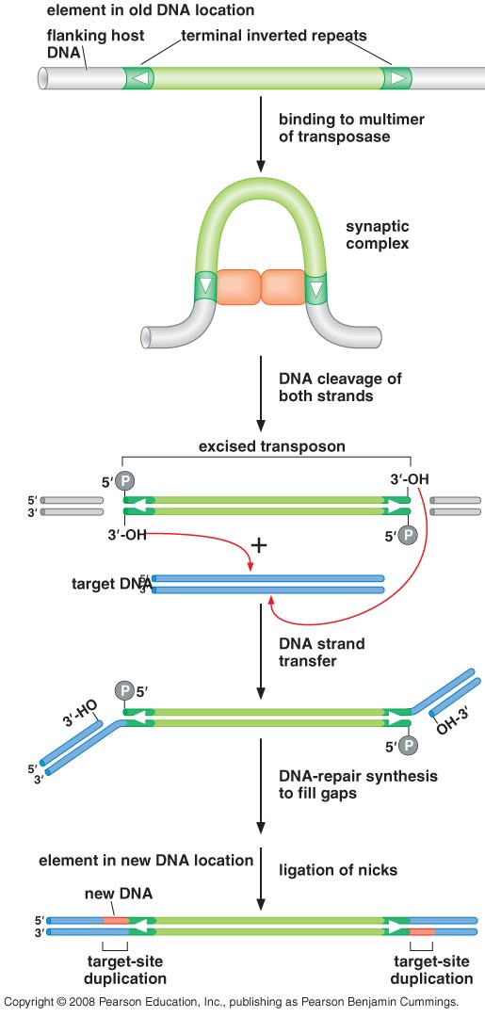
Cut and paste mechanism of transposition
transposome
Notes:
Different transposons use different mechanisms to cleave the second strands
Target DAN can have any sequence
The transposome ensures that the two ends of the transposon DNA attack the two DNA strands of the same target site together.
The sites of attack on the two strands usually separated by a few nucleotides (2, 5 or 9 bases). This distance is fixed for each type of transposon and gives rise to the short target-site duplications that flank transposed copies of the element
Filling in the gaps gives rise to the target-site duplications that flank transposons

Slide 38
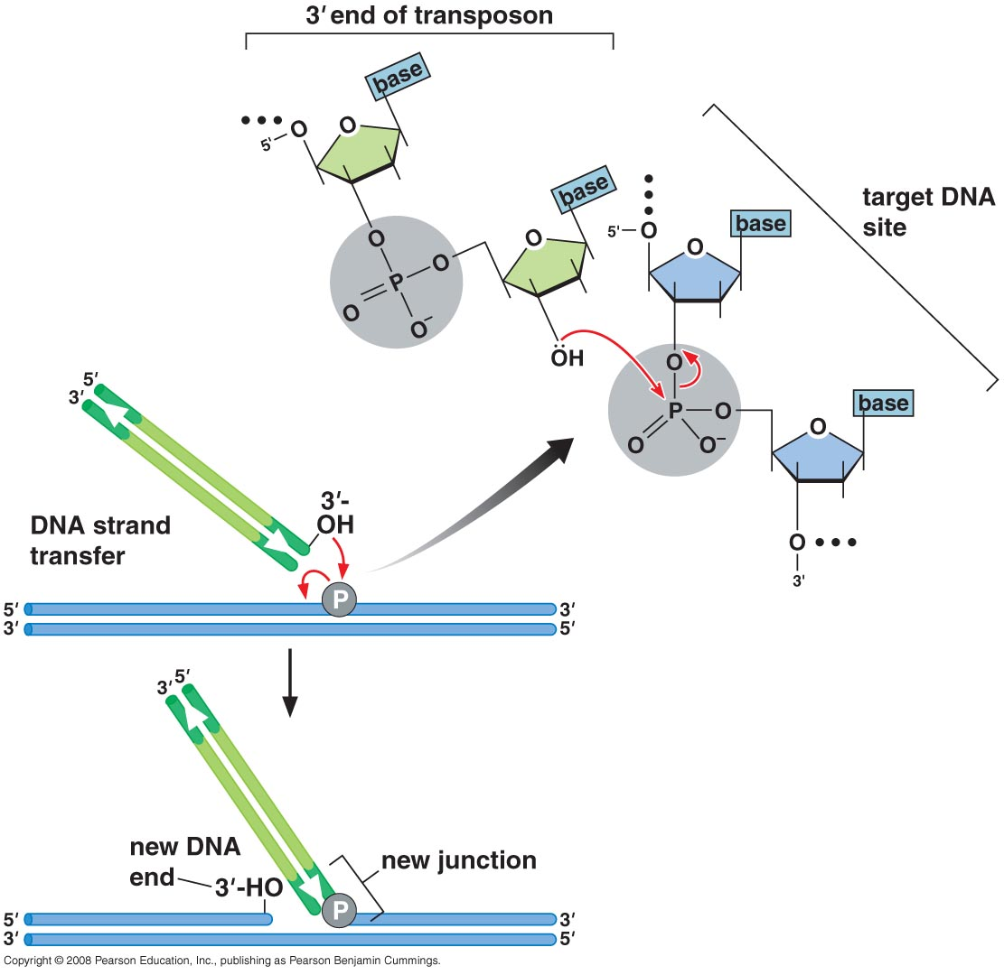
DNA strand transfer

Slide 39
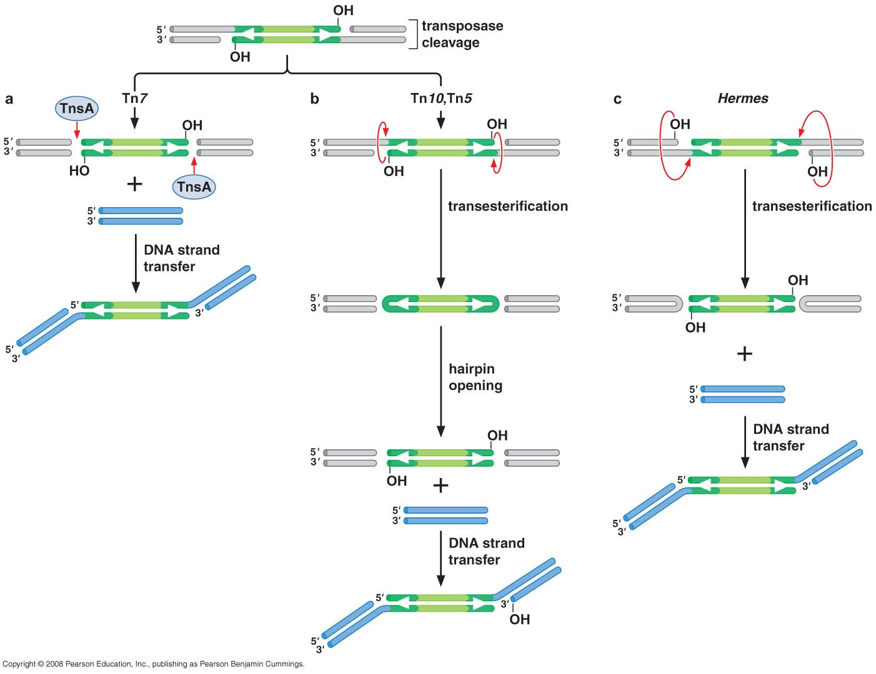
Three Mechanisms for Cleaving the Non-transferred Strand
Another enzyme is used
nontransferred strands: their 5’ends are not directly linked to the target DNA during the DNA strand transfer.
Notes:
The transposase cleaves the 3’ends of the element DNA and promotes DNA strand transfer to catalyze cut and paste transposition.
The other 5’-terminating strands at the junctions between the transposon and the flanking host DNA must be cleaved too.
These DNA strands are called nontransferred strands as their 5’ends are not directly linked to the target DNA during the DNA strand transfer.
Why might transposases use transesterification as a cleavge mechinsm?
Probably economic solution

Slide 40
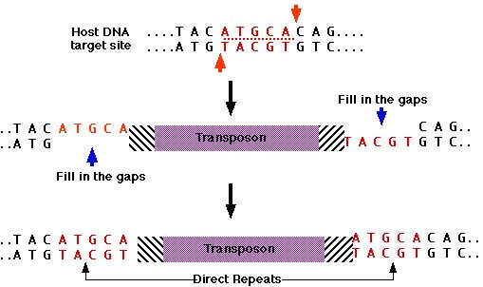
What makes DNA direct repeats?

Slide 41
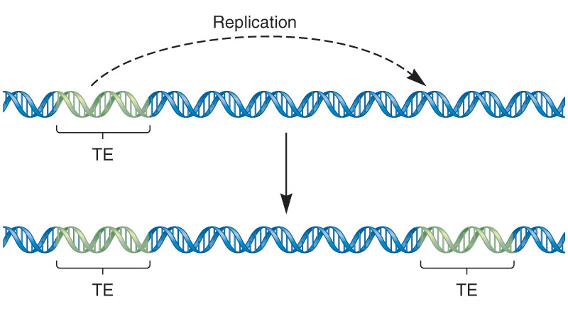
Replicative Transposition

Slide 42
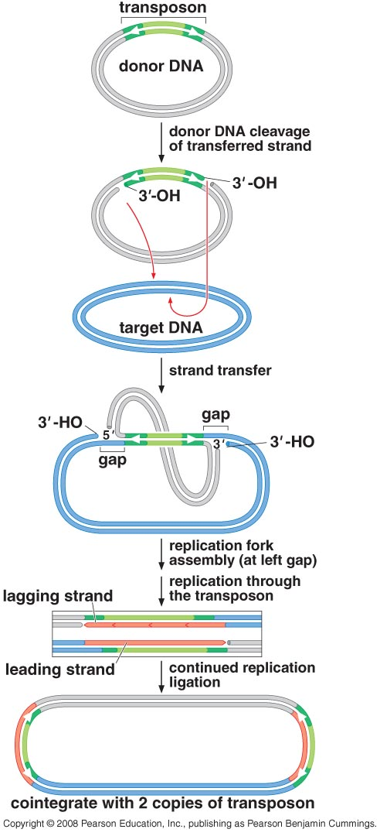
Mechanism of Replicative Transposition
Notes:
First step is assembly of the transposase protein on the two ends of the transposon DNA to generate a transposome
Next step is DNA cleavage at the ends of the transposon DNA. This is catalyzed by the transposase within the transposome
The transposase introduces a nick into the DNA at each of the two junctions between the transposon sequence and the flanking host DNA
This cleavage liberates the two 3’OH DNA ends on the transposon sequence
In contracts to cut and paste transposition, the transposon DNA is not excised from the host sequence at this stage (major difference)
The 3’OH ends of the transposon DNA are then joined to the target DNA site by the DNA strand transfer reaction (same as cut and paste) but the intermediate generated by DNA strand the DNA strand transfer in this case is a doubly branched DNA molecule
In this intermediate, the 3’ends of the transposon are covalently joined to the new target site whereas the 5’ends of transposon sequence remain joined to the old flanking DNA
The two DNA branches within this intermediate have the structure of a replication fork. After DNA strand transfer , the DNA replication proteins from the host cell can assemble at these forks
The 3’OH end in the cleaved target DNA serves as a primer for DNA synthesis
Replication proceeds through the transposon sequence and stops at the second fork.
This replication generates two copies of the transposon DNA

Slide 43
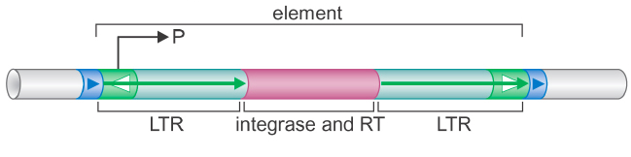
II- Viral-like Retrotranposons (retroviruses)
Inverted terminal repeats (ITR) embedded within longer direct repeat (LTR)
Transposase (integrase)
Reverse transcriptase (RT)
Viral like Vs Retroviruses

Slide 44
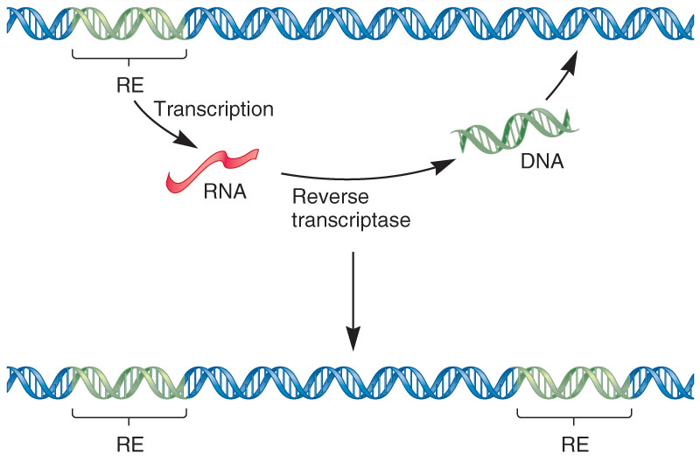
Retrotransposition

Slide 45
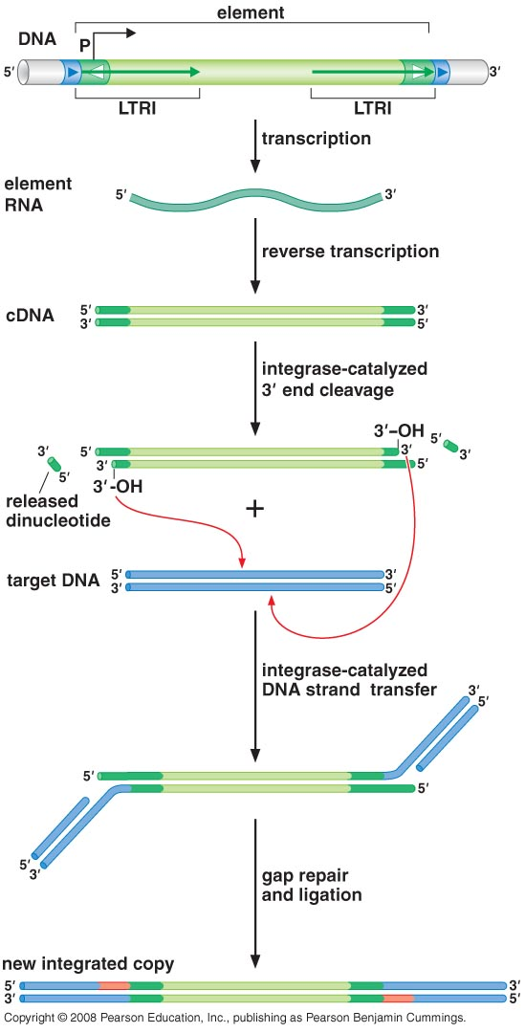
Mechanism of retroviral transposition
Transcription within LTR by RNA polymerase
cDNA by RT
Integrase recognize cDNA
No need for 2nd strand cut
3`-OH attack target DNA
Notes:
As the direct precursor DNA for integration is generated from the RNA template by reverse transcription , it is already in the form of an excised transposon. NO need for a mechanism to cleave the second strand
Integrase can catalyze the insertion of these cleaved 3’ends into the target DNA site in the host cell genome using the DNA strand transfer reaction
Because transcription to generate the RNA intermediate initiates within one of the LTRs, this RNA does not carry the entire LTR sequence; the sequence between the transcription start site and the end of the element is missing. Therefore, a special mechanism is needed to regenerate the full length element sequence during reverse transcription. This involves two internal priming events and two strand switches.

Slide 46
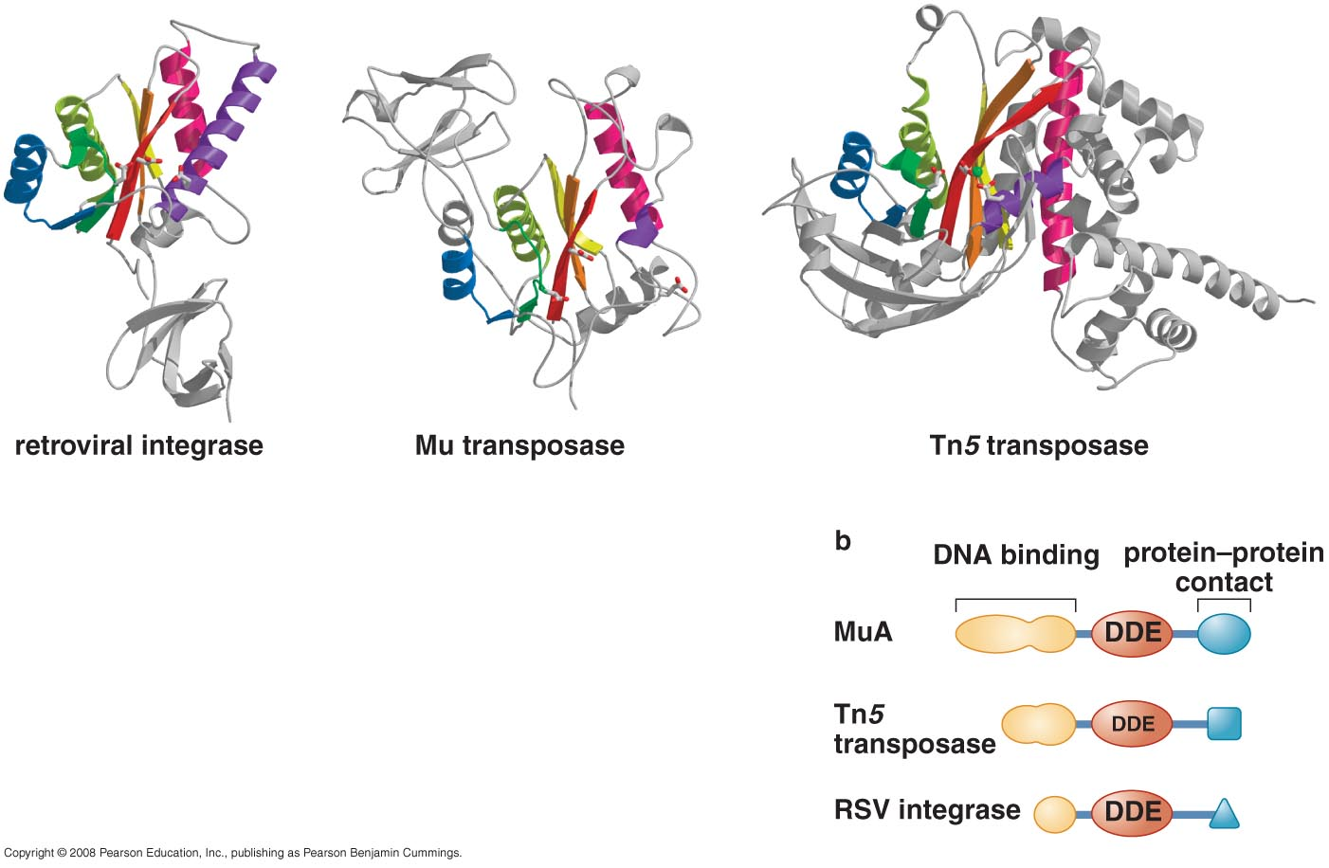
DNA Transposases and retroviral integrases are members of the same protein superfamily
Highly conserved catalytic domains
Conserved acidic a.a site
2 aspartates (D) + glutamate (E)
DNA binding site & protein-protein interaction are different
Notes:
They use the same active site to catalyze both the DNA cleavage and DNA strand transfer rather than having two active sites
Are active only when assembled into a synaptic complex (transposome) on DNA

Slide 47
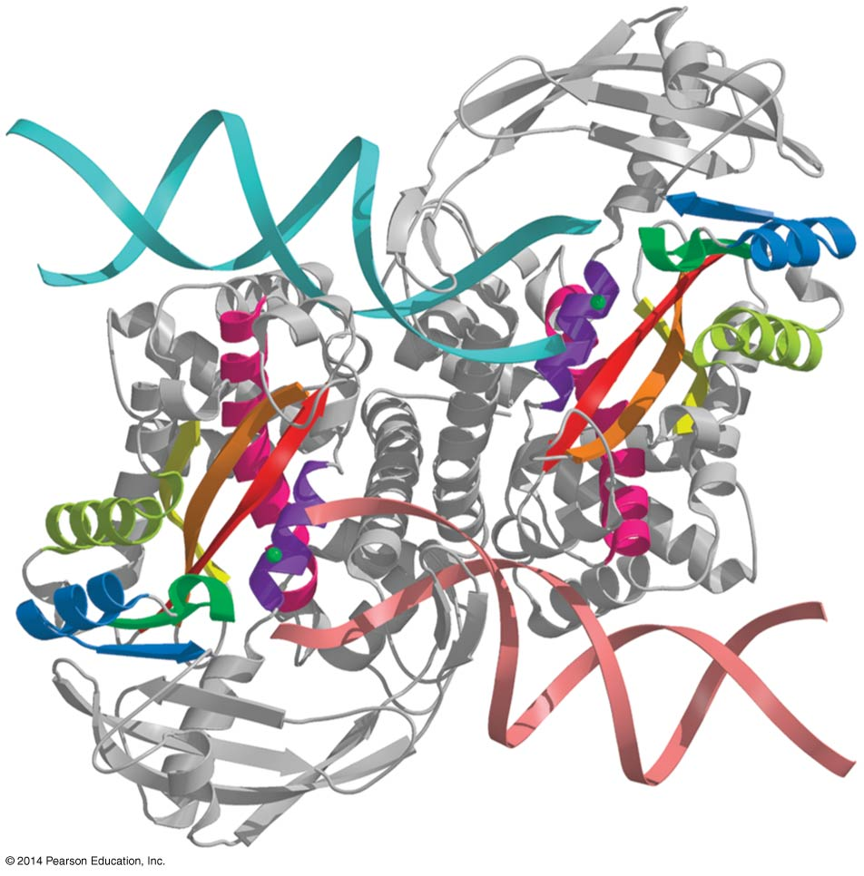
Figure 12-25
Cocrystal of Tn5 bound to substrate DNA.
The complex contains dimer of transposase.
Notes:
47
Figure 12-25

Slide 48
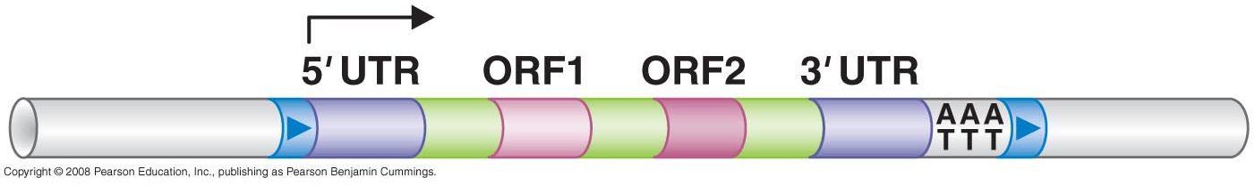
III- Poly-A Retrotranposons Target site primed reverse transcription
Untranslated regions 5’UTR & 3’UTR
RNA synthesis begins at first nucleotide of element
Stretch of A-T sequence (poly-A sequence)
ORF1
ORF2

Slide 49
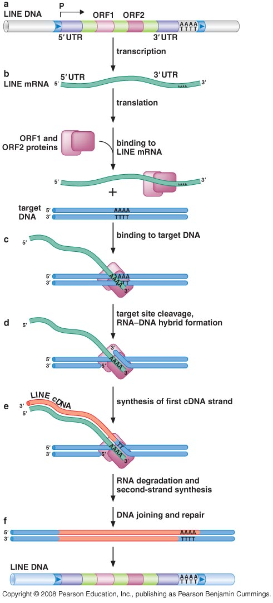
LINE poly-A Retrotransposon Movement by target-site-directed splicing mechanism
ORF1 = RNA binding protein
ORF2 = reverse transcriptase & endonuclease
By cellular RNA polymerase
in cytoplasm
re-enters
nucleus

Slide 50
The endonuclease activity of ORF2 initiates the integration rxn by introducing a nick in the chromosomal DNA.
T-rich sequences are preferred cleavage sites.
This permits the DNA to base pair with polyA tail sequence of element RNA
The 3’OH DNA end generated by the nicking rxn then serves as the primer for RT of the element RNA. ORf2 catalyze this step
Notes:
The remaining steps of transposition, although not yet well-understood, include synthesis of the second cDNA strand, repair of DNA gaps at the insertion site, and ligation to seal the DNA strands

Slide 51
Examples of Transposable Elements and Their Regulation

Slide 52
Regulation of transposons
Transposons control the number of their copies present in a given cell (limit their deleterious impact on the genome
Transposons control target-site choice:
Some elements preferentially insert into regions of chr that tend not to be harmful to the host cell (safe haven regions)
Some transposons specifically avoid transposing into their own DNA (called transposition target immunity)

Slide 53
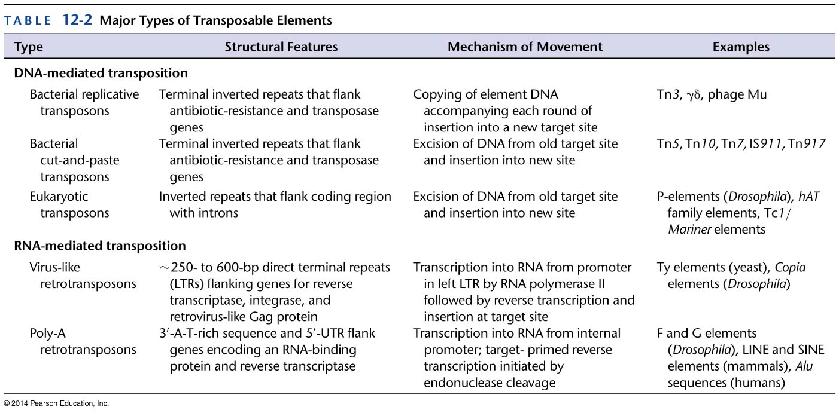
Table 12-2
Notes:
53
Table 12-2

Slide 54
IS4-family (Tn10)
An example of bacterial DNA transposon, 9 kb
Transpose by cut & paste.
Composite transposon: Tn10 is organized into three functional modules.
Control of transposase expression by anti sense RNA

Slide 55
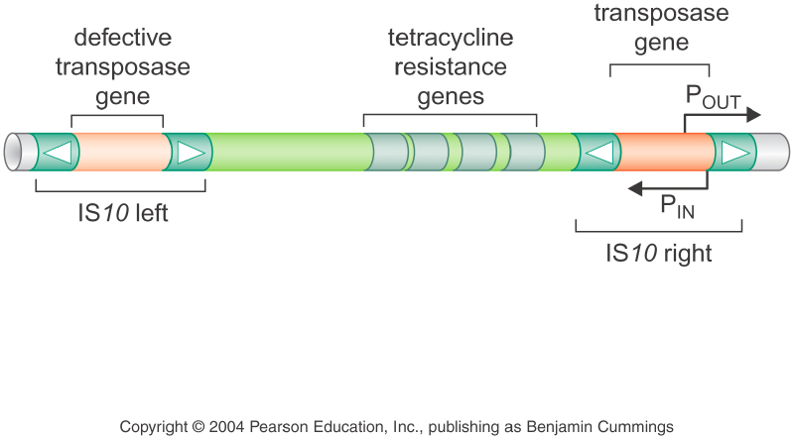
Composite Transposon
Non autonomous
Autonomous
Autonomous

Slide 56
Control of transposase expression
Two promoters at IS10 right that directs the RNA synthesis by the host cell’s RNA polymerase
P_{IN}: directs synthesis of transposase gene
P_{OUT}: anti-sense RNA

Slide 57
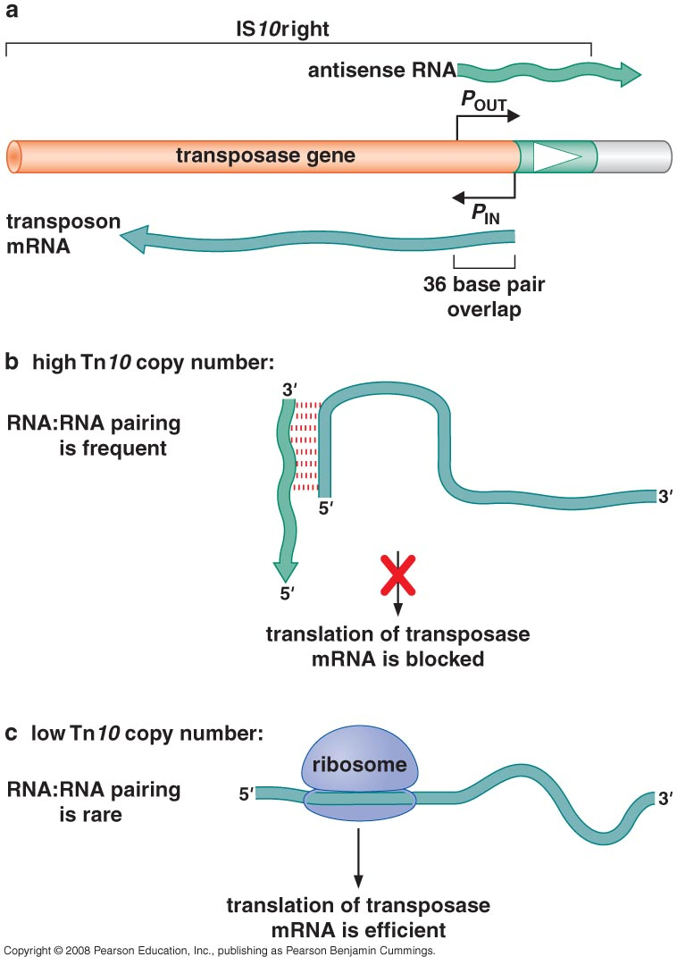
Antisense Copy Control

Slide 58
Mu Phage: example of target sequence control
Very active transposon
40 kb & carries 35 genes
Use replicative transposition to amplify its DNA
During lytic cycle, Mu completes ~ 100 rounds of transposition per hour
2 genes responsible for transposition
MuA: transposase (member of DDE protein superfamily)
MuB: ATPase (stimulates MutA activity and controls choice of the DNA target)
To avoid transposing to its own DNA, its transposition is regulated by transposition target immunity.
Notes:
Mu for mutator from its ability to transpose frequently

Slide 59
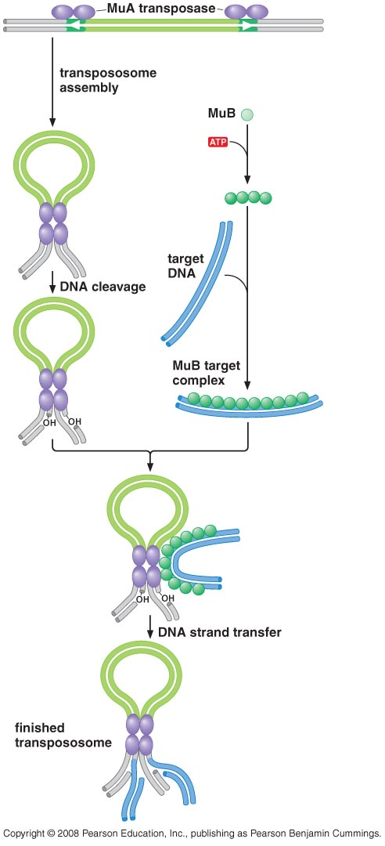
Mu Transposition

Slide 60
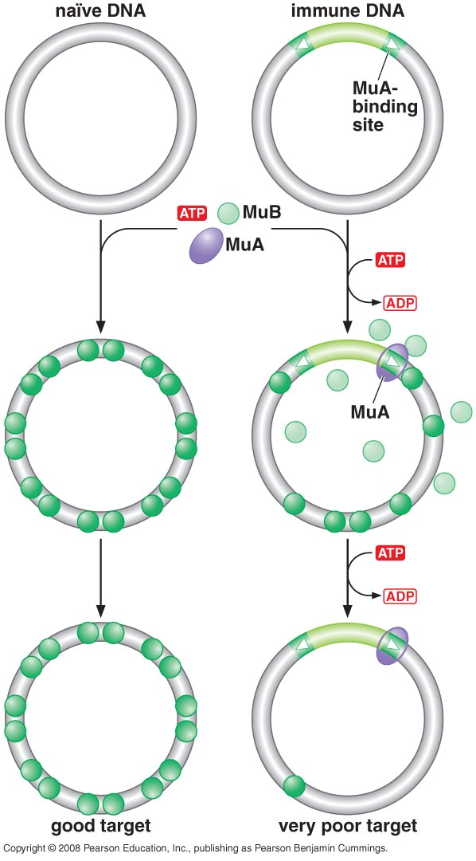
Transposition target immunity
MuA inhibits MuB from binding to nearby DNA sites.
This inhibition requires ATP hydrolysis
MuB helps MuA find a target site for transposition
MuA binding site provide immunity to 5-15kb
MuA/MuB.ATP interaction
↓
ATP hydrolysis
↓
Disassociation of MuB

Slide 61
Tc1/Mariner Element
Most common in Eukaryotes
Tc from C. elegans; Mariner from Drosophila
Simplest autonomous transposon (1.5-2.5 kb, DDE member, no accessory proteins are needed )
Cut & paste transposition
Preferred target DNA 5’TA
What happens to the empty site in the host chromosome? Broken ends are filled in and directly joined → insertion of few extra bases at old insertion called footprints
Transposition is not regulated → many are dead (carry mutations in transposase)
Artificial hyperactive Tc1/mariner called Sleeping beauty; transposes at very high frequencies compared with naturally isolated elements. (research tool for mutagenesis)

Slide 62
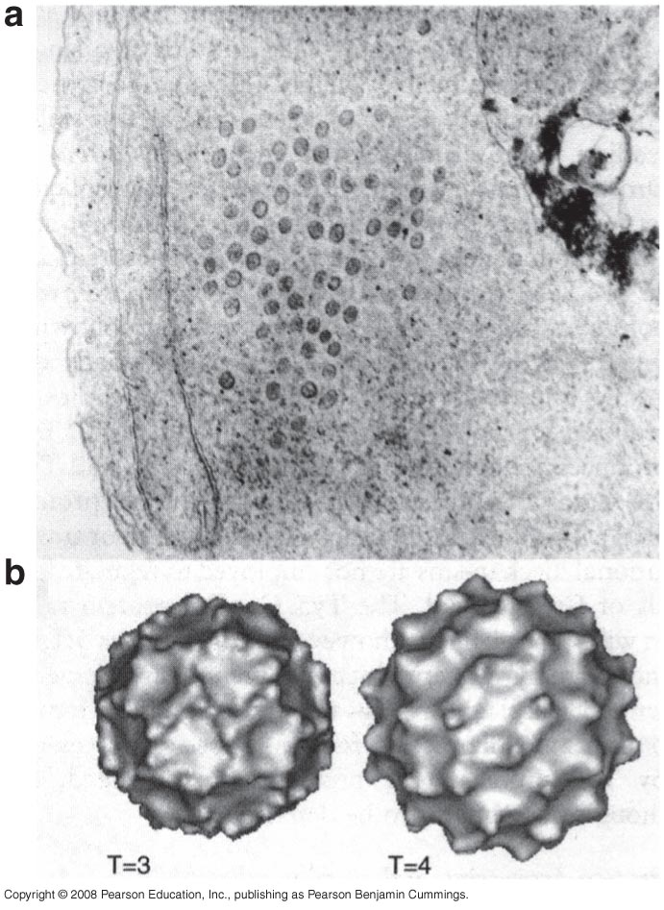
Ty Elements (transposon in yeast)
Viral like retrotransposon
Ty RNA is found in cells packed into virus-like particles
Preferentially integrate into specific chromosomal regions e.g Ty1 within ~ 200 bp upstream of a start site for transcription of host RNA Pol III enzyme (tRNA genes)
Slow transposon
Different types: (Ty1,2, …, Ty5)
Enables the transposons to persist in host by focusing on away from important regions

Slide 63
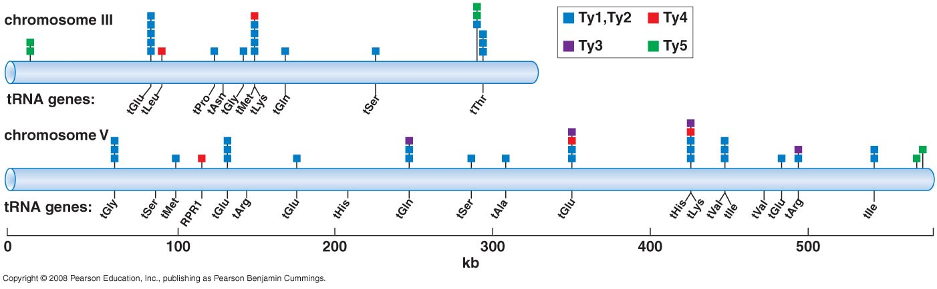
Clustered integration sites observed for Ty elements

Slide 64
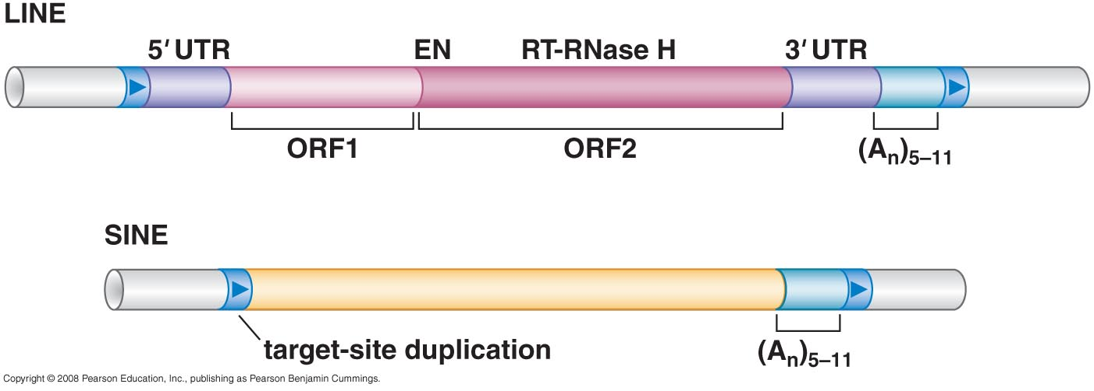
LINE (Long interspersed nuclear element) SINE (Short interspersed nuclear element)
LINE is autonomous poly-A retrotransposone
Provide reverse transcriptase & integrase to SINE
LINE form 20% of human genome,100-400 bp in length
SINE widely present, most common Alu

Slide 65
How LINEs avoid transposing cellular mRNA molecules?
LINE-encoded proteins bind immediately to their own RNA during translation.
Thus, they show a strong bias to catalyzing reverse transcription and integration of the RNA that encoded them
Rarely mRNA is targeted by ORF1 and ORF2 producing processed pseudogenes.
Pseudogenes are functionless relatives of genes that have lost their gene expression in the cell or their ability to code protein.

Slide 66
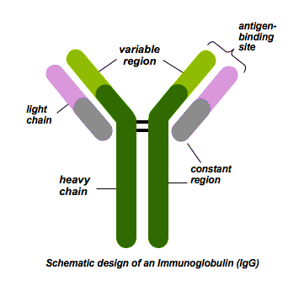
Antibodies
Vertebrates:
B cells produce antibodies that circulate in the blood stream, whereas
T cells produce cell-surface receptor proteins (T-cell-receptors)
The principal mechanism cells use to generate antibodies and T-cell receptors with such diversity relies on a specialized set of DNA rearrangement called V(D)J recombination
Notes:
Antibodies are made of proteins that bind to a specific part or determinant of an antigen called an epitope. Each epitope occurs many times, or is studded on the surface of a pathogen. The antibodies that are produced act as the functional units of the immune response. Shaped like a “Y”, the antibody has two sites at the tip of the Y which are the binding sites of the antibody for the antigen.

Slide 67
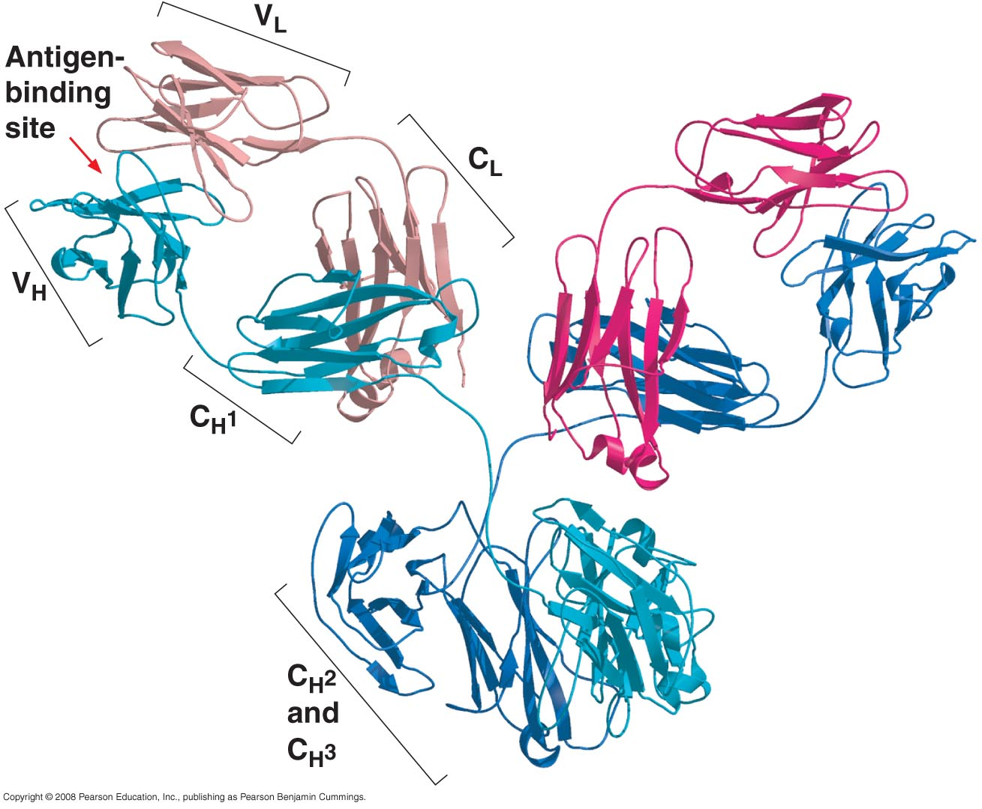

Slide 68
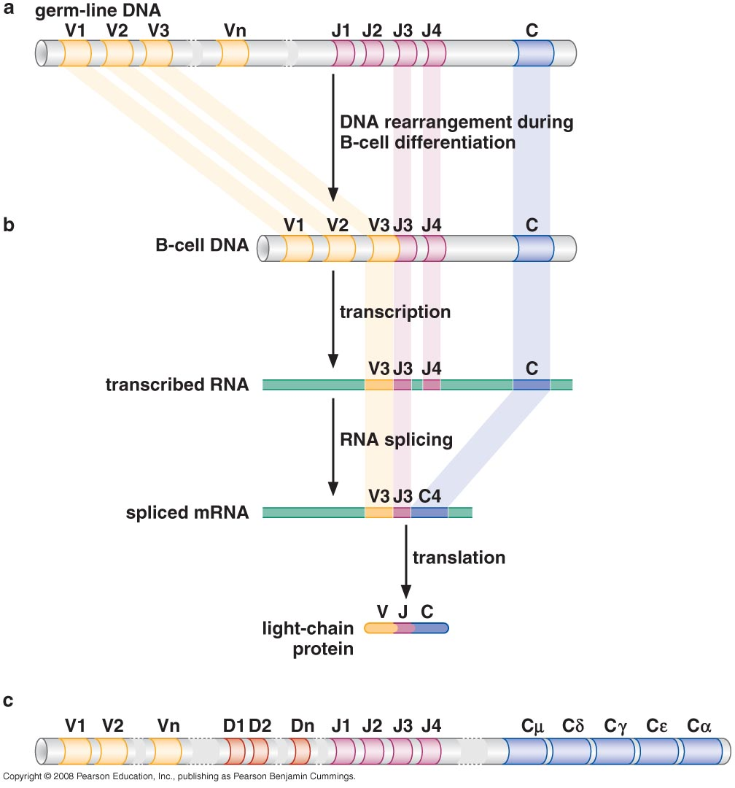
V(D)J Recombination
Light Chain
~300 V gene segment
~ 4 J gene segment
Heavy Chain
~100 V gene segment
12 D gene segment
4 J gene segment
4X300=1200
100X12X4=4800

Slide 70

Mechanism of Recombination
Fixed sequence at the boundaries of each segment called recombination signal sequences
Each consensus sequence consists of heptamer separated by either 12 or 23 bp from a nanomer

Slide 71

Mechanism of Recombination
Recombination Rule:
A sequence with one type of spacing can be joined only to a sequence with the other type of spacing

Slide 72

Mechanism of Recombination
The similarities between the mechanism of DNA cleavage to initiate V(D)J recombination and transposon excision are remarkable
Recombination signal and the RAG1 and RAG2 proteins has some sequence similarity to the DDE transposase protein family
Recent genomic analysis uncovered a transposon family called Transib that are the likely source of both RAG1 and the recombination signal sequence
RAG: recombination activating gene
recombinase
transesterification
Notes:
RAG (Recombination Activating Gene)

Slide 73
END

